Slide 1





Introduction to ML.NET
#GlobalAINight
Marco Parenzan

Slide 2
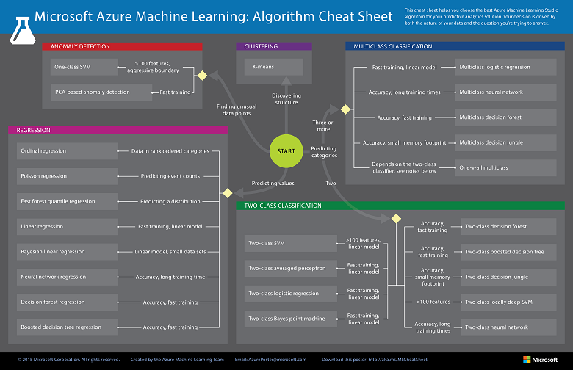

Slide 3
Artificial Intelligence
Artificial Intelligence
Machine Learning
Deep Learning
Neural Networks
Regression
Classification
Anomaly Detection
Conversational Agents
Text Analytics
Computer Vision

Slide 4
Why now and not before?
Theory since ’50s/’60s/’70s
Obstacles
Strong math skills
Continuous training
Now
computing power
Commodity and Cloud
Discipline (components, API, microservices)
Everyone asks

Slide 5
Everyone is a Data Scientist
«The italian way ☺»

Slide 6
Two roles
Who create (and train) the model (the new «component» market)
Who consume the model

Slide 7
Something really happened (a week ago)
Example IoT scenario
(another example of «why now»)
Solution in Python
Python has won
.NET (Core) Crysis
Spikes handled with thresholds (and hysteresys)
Work on levels
Failure on this solution
Thresholds changes, slope not
I said «why don’t you use scikit learn»?
Answer: «Too difficult»

Slide 8

Difficulties of «modern» ML
Derivatives/gradients
Limits
Series
Distributions
Is this a face?
Price of Shirt?
f(x)
f(x)
“It has exquisite buttons … with long sleeves …works for casual as well as business settings”

Slide 9
ML.NET 1.0
ML.NET 1.0 @Build 2019
Machine Learning framework for building custom ML Models
Custom ML made easy - Automated ML and Tools (Model Builder and CLI)
Proven at scale (Azure, Office, Windows )
Extensible (TensorFlow, ONNX and Infer.NET)
Cross-platform and open-source - Runs everywhere

Slide 10
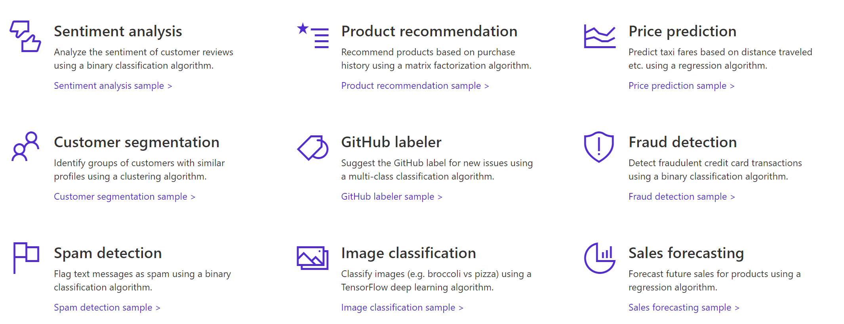

A few things you can do with ML.NET 1.0 …

Slide 11
Three key concepts

Slide 12
1. Data
Data
Example
Comment Text | Sentiment
Wow... Loved this place. | 1
Crust is not good. | 0
Not tasty and the texture was just nasty. | 0
The selection on the menu was great. | 1
Notes:
Dataset: https://github.com/dotnet/machinelearning/blob/master/test/data/wikipedia-detox-250-line-data.tsv

Slide 13
2. Transformers
Data
Data
Transformer
Data
Example
Text
Wow... Loved this place.
Crust is not good.
Not tasty and the texture was just nasty.
The selection on the menu was great.
Featurized Text
[0.76, 0.65, 0.44, …]
[0.98, 0.43, 0.54, …]
[0.35, 0.73, 0.46, …]
[0.39, 0, 0.75, …]
Text Featurizer
Notes:
Transformers take data, do some work on it, and return new transformed data.
One example of a transformer we will need in our example is a Text Featurizer, which takes the text in the issue text and converts it to numbers that our ML algorithms can understand.

Slide 14
3. Estimators
Data
Data
Transformer
Data
Data
Estimator
Transformer
Example
Comment | Sentiment
Wow... Loved this place. | 1
Crust is not good. | 0
Not tasty and the texture was just nasty. | 0
The selection on the menu was great. | 0
Estimator
Model (Transformer)
Notes:
An estimator learns from data to create a transformer. Now a model, which turns the input features into output predictions, is a transformer. So we can take estimators that take our example data and produce a model.

Slide 15
ML Demos
Regression
Infer future values (interpolation?) from the past
Classification
When the data are being used to predict a category
When there are only two choices, it's called binary classification.
When there are more categories it is called multi-class classification.
Anomaly Detection
identify data points that are simply unusual

Slide 16
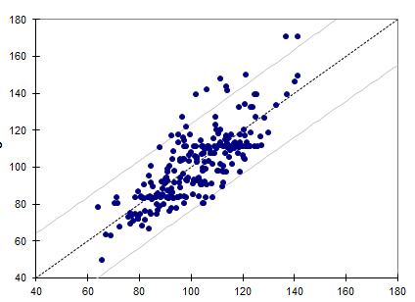
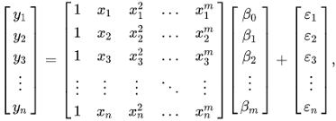
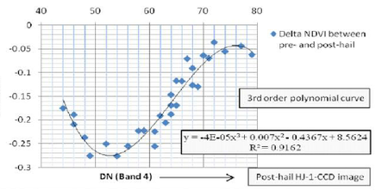
Linear/Polynomial/Functional Regression

Slide 17
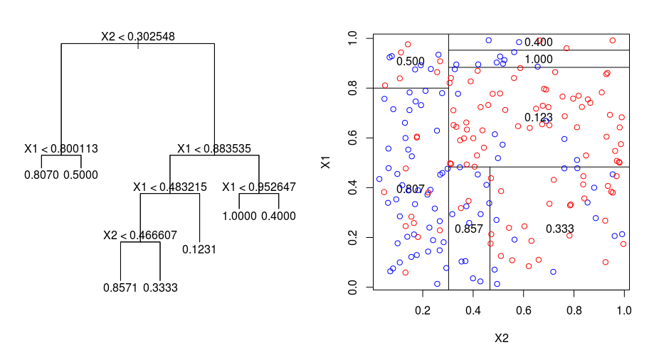
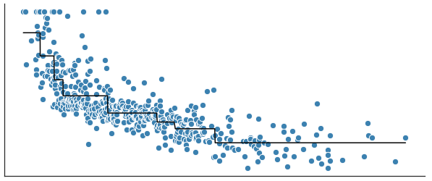
Regression Trees
A decision (or regression) tree is a binary tree-like flow chart, where at each interior node one decides which of the two child nodes to continue to based on one of the feature values from the input.

Slide 18
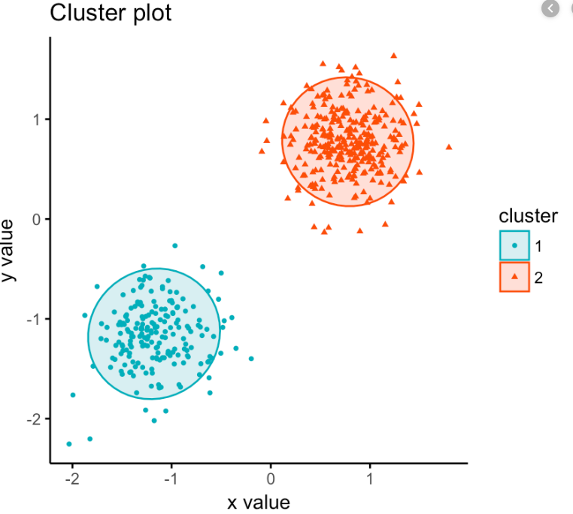
Clustering

Slide 19
DL Demos
Object Detection

Slide 20













Open and Interoperable AI
CPU
GPU
FPGA
ASIC
ONNX Runtime

Slide 21


4 ways to get an ONNX model
ONNX Model Zoo
Custom Vision Service
Convert existing models
Train models in Azure Machine Learning

Slide 22
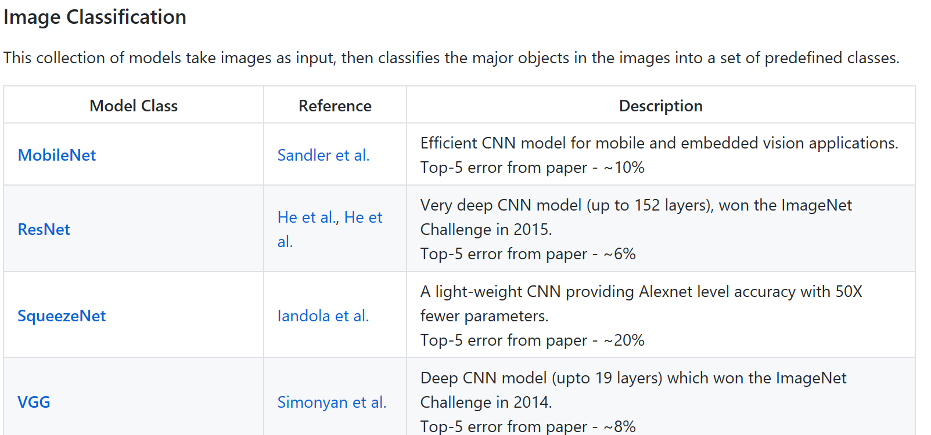
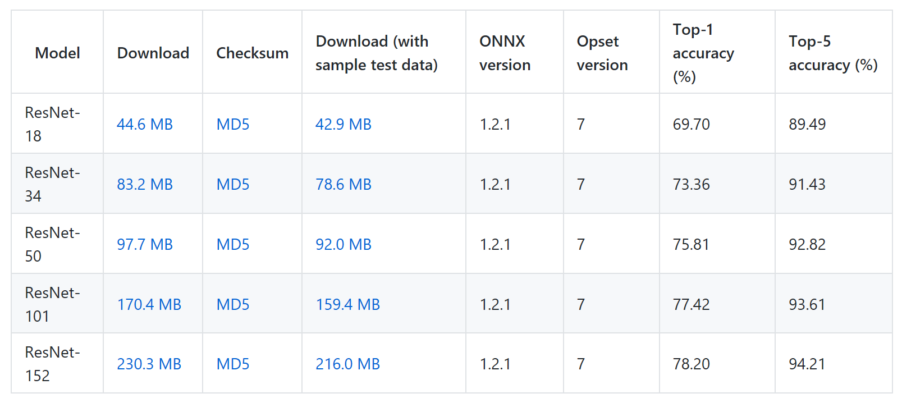
ONNX Model Zoo: github.com/onnx/models

Slide 23
AutoML

Slide 24
Model Creation Is Typically Time-Consuming
Which features?
Which algorithm?
Which parameters?
Mileage
Condition
Car brand
Year of make
Regulations
…
Gradient Boosted
Nearest Neighbors
SVM
Bayesian Regression
LGBM
…
Parameter 1
Parameter 2
Parameter 3
Parameter 4
…
Mileage
Gradient Boosted
Criterion
Loss
Min Samples Split
Min Samples Leaf
Others
Car brand
Year of make
30%
Model

Slide 25
Model Creation Is Typically Time-Consuming
Which features?
Which algorithm?
Which parameters?
Mileage
Condition
Car brand
Year of make
Regulations
…
Gradient Boosted
Nearest Neighbors
SVM
Bayesian Regression
LGBM
…
Criterion
Loss
Min Samples Split
Min Samples Leaf
Others
Mileage
Gradient Boosted
N Neighbors
Weights
Metric
P
Others
Condition
Nearest Neighbors
Car brand
Car brand
50%
Year of make
30%
Year of make
Model
Iterate

Slide 26
Model Creation Is Typically Time-Consuming
Which features?
Which algorithm?
Which parameters?
30%
50%
70%
30%
45%
50%
65%
95%
35%
10%
75%
20%
70%
30%
15%
Iterate

Slide 27
Automated ML Accelerates Model Development
Input
Intelligently test multiple models in parallel
Output
25%
Optimized model
25%
40%
Enter data
70%
25%
40%
70%
95%
95%
Define goals
25%
40%
70%
25%
40%
25%
70%
Apply constraints
40%

Slide 28
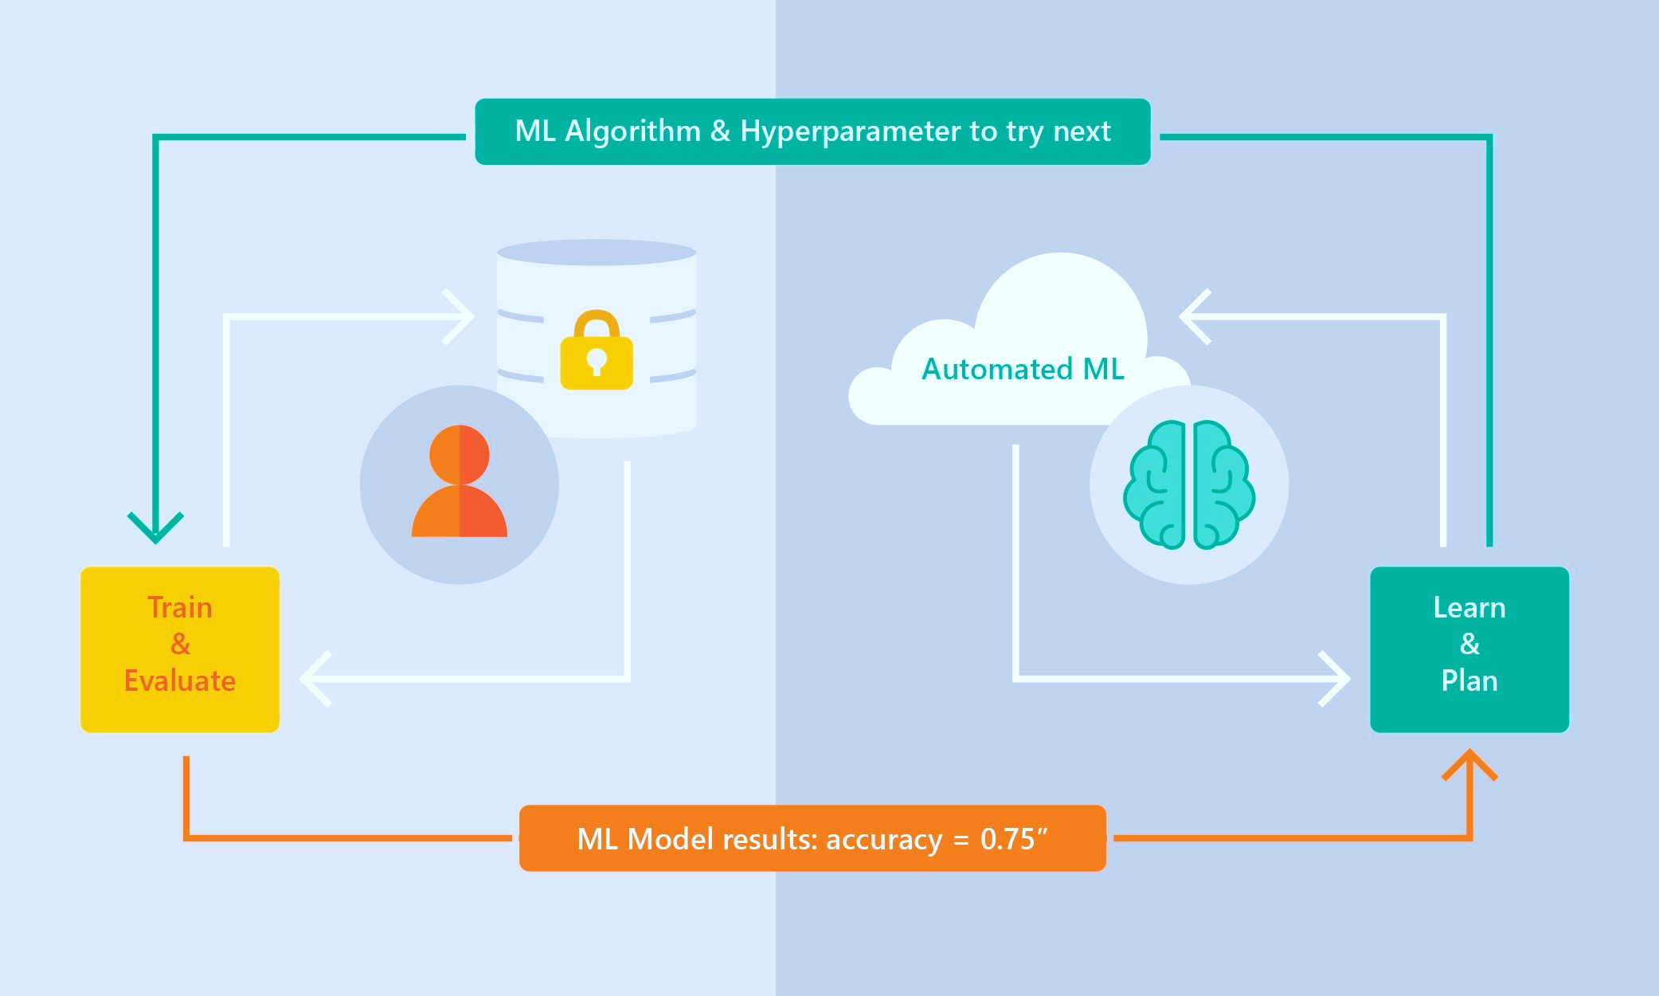
Automated ML Capabilities
Based on Microsoft Research
Brain trained with several million experiments
Collaborative filtering and Bayesian optimization
Privacy preserving: No need to “see” the data

Slide 29
Thanks!

